Slide 1

Residential Foundations
He who has not first laid his foundations may be able with great ability to lay them afterwards, but they will be laid with trouble to the architect and danger to the building. Niccolo Machiavelli (1469 - 1527), The Prince
Civil Engineering and Architecture
© 2010 Project Lead The Way, Inc.

Slide 2
Foundations
Purpose
Considerations
Types of Foundations
  Shallow Foundations
    Spread Footings
    Strip Foundations
    Slab-on-Grade and Thickened Slabs
Notes:
Civil Engineering and Architecture
Unit 2- Lesson 2.3 – Residential Design
Project Lead The Way, Inc
Copyright 2010
Residential Foundations

Slide 3
Purpose of Foundations
Provide a level, stable surface to safely support a building
Transfer building loads to soil
Anchor the building from wind, flood, and seismic loads
Notes:
Civil Engineering and Architecture
Unit 2- Lesson 2.3 – Residential Design
Project Lead The Way, Inc
Copyright 2010
Residential Foundations

Slide 4
Design Considerations
Loads from the structure
Allowable soil bearing pressure
Frost depth
Flood elevation
Drainage
Costs
Notes:
Civil Engineering and Architecture
Unit 2- Lesson 2.3 – Residential Design
Project Lead The Way, Inc
Copyright 2010
Residential Foundations

Slide 5
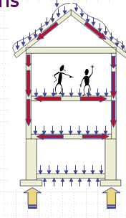
Loads from the Structure
Foundations Must Resist
  Dead Load
    Weight of building
  Live Load
    Weight of occupants, furniture, and equipment
  Lateral Loads
    Wind
    Seismic activity
    Flood
SOIL REACTIONS
Notes:
The foundation must resist the design load combinations that are specified by building codes. For instance, dead and live loads must be considered together. Dead and live loads will be transferred through the structural components to the earth, which will cause a soil reaction pressure.
Some load combinations may actually cause the building to lift up from the foundation. For example, a load combination included in the IBC requires that only 60% of the dead load be combined with wind and lateral earth pressure. The wind and lateral earth pressure can cause a tipping effect on the building which will increase the soil reaction on one side of the building, but may actually lift up one side of the building. The foundation must be able to safely transfer both downward and upward forces into the earth.
Civil Engineering and Architecture
Unit 2- Lesson 2.3 – Residential Design
Project Lead The Way, Inc
Copyright 2010
Residential Foundations

Slide 6
Allowable Soil Bearing Pressure
Indicates the maximum pressure that a soil may be designed to support
Typically presented in pounds per square foot (psf)
Different types of soils have different allowable soil bearing pressures
Notes:
Civil Engineering and Architecture
Unit 2- Lesson 2.3 – Residential Design
Project Lead The Way, Inc
Copyright 2010
Residential Foundations

Slide 7
Soil Information
Local building department, codes, and regulations
Preliminary information: USDA Web Soil Survey http://websoilsurvey.nrcs.usda.gov
Local or state building codes
Soil testing/analysis
  Site inspection and simple soil testing
  Soil borings taken at proposed foundation locations
Notes:
Information on types of soils present on a site and/or the allowable soil bearing pressure are available through many sources. However, since residential structures are relatively light in weight, an investigation of the allowable soil bearing pressure is rarely justified. Standard foundation types and sizes are based on local practice and minimum code requirements unless there are extenuating circumstances.
We will investigate soil bearing capacity later in the course when we design larger commercial facilities.
Civil Engineering and Architecture
Unit 2- Lesson 2.3 – Residential Design
Project Lead The Way, Inc
Copyright 2010
Residential Foundations

Slide 8
Frost Depth
Freezing of soil can cause heaving of foundations
Silt or clay soils with a high water table are highly susceptible to frost
Defense
Build base of foundation below frost depth
Provide frost protection for foundation
Notes:
Civil Engineering and Architecture
Unit 2- Lesson 2.3 – Residential Design
Project Lead The Way, Inc
Copyright 2010
Residential Foundations

Slide 9
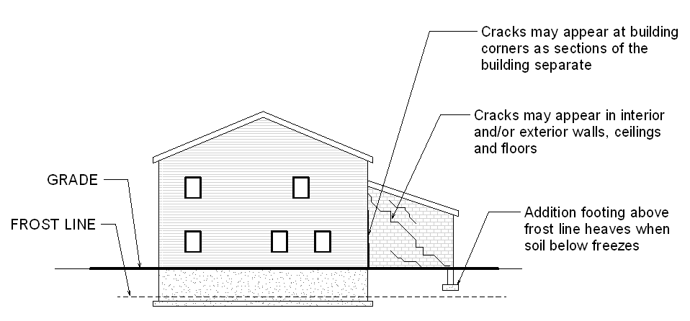
Frost Heave
Notes:
This image shows the result of frost heave on an addition to a building. The new foundation was placed above the frost line. When the supporting wet soil froze, the ice build-up forced the foundation to lift up, causing cracking in the walls and floor.
Civil Engineering and Architecture
Unit 2- Lesson 2.3 – Residential Design
Project Lead The Way, Inc
Copyright 2010
Residential Foundations

Slide 10
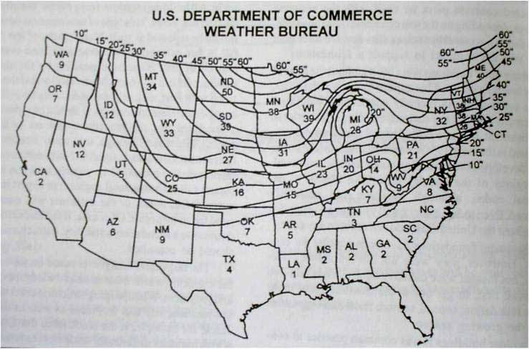
Frost Depth Contour Map
Notes:
This frost depth contour map shows approximate frost depths across the continental United States; however, it provides only an estimate. The numbers under each state symbol represent the average frost depth for the state. The contour lines give a better estimate. Find your location and make a note of the frost depth.
Note: the Affordable Home site is located approximately where the IN is placed on the map, and the frost depth is estimated at 20 inches.
The bottom of the foundation must be placed below this frost depth to prevent frost heave.
Be aware that this map provides only an approximation of the frost depth – local conditions will control. Check your local codes for frost penetration requirements.
Civil Engineering and Architecture
Unit 2- Lesson 2.3 – Residential Design
Project Lead The Way, Inc
Copyright 2010
Residential Foundations

Slide 11
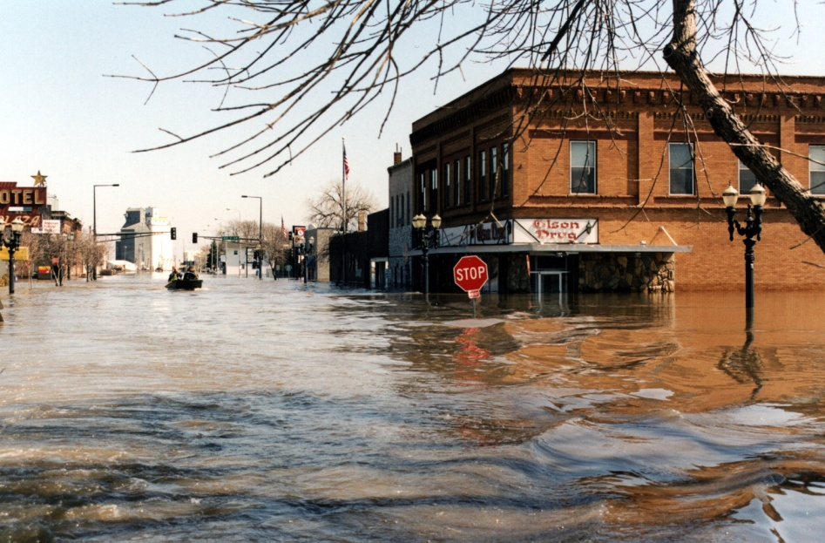
Flood Elevation
Inundation by flood waters should be avoided
  Damage to structure
  Damage to contents
Height of floors is dictated by building codes and should be above flood levels
Courtesy Federal Emergency Management Agency. Photographer Dave Saville.
Notes:
Civil Engineering and Architecture
Unit 2- Lesson 2.3 – Residential Design
Project Lead The Way, Inc
Copyright 2010
Residential Foundations

Slide 12
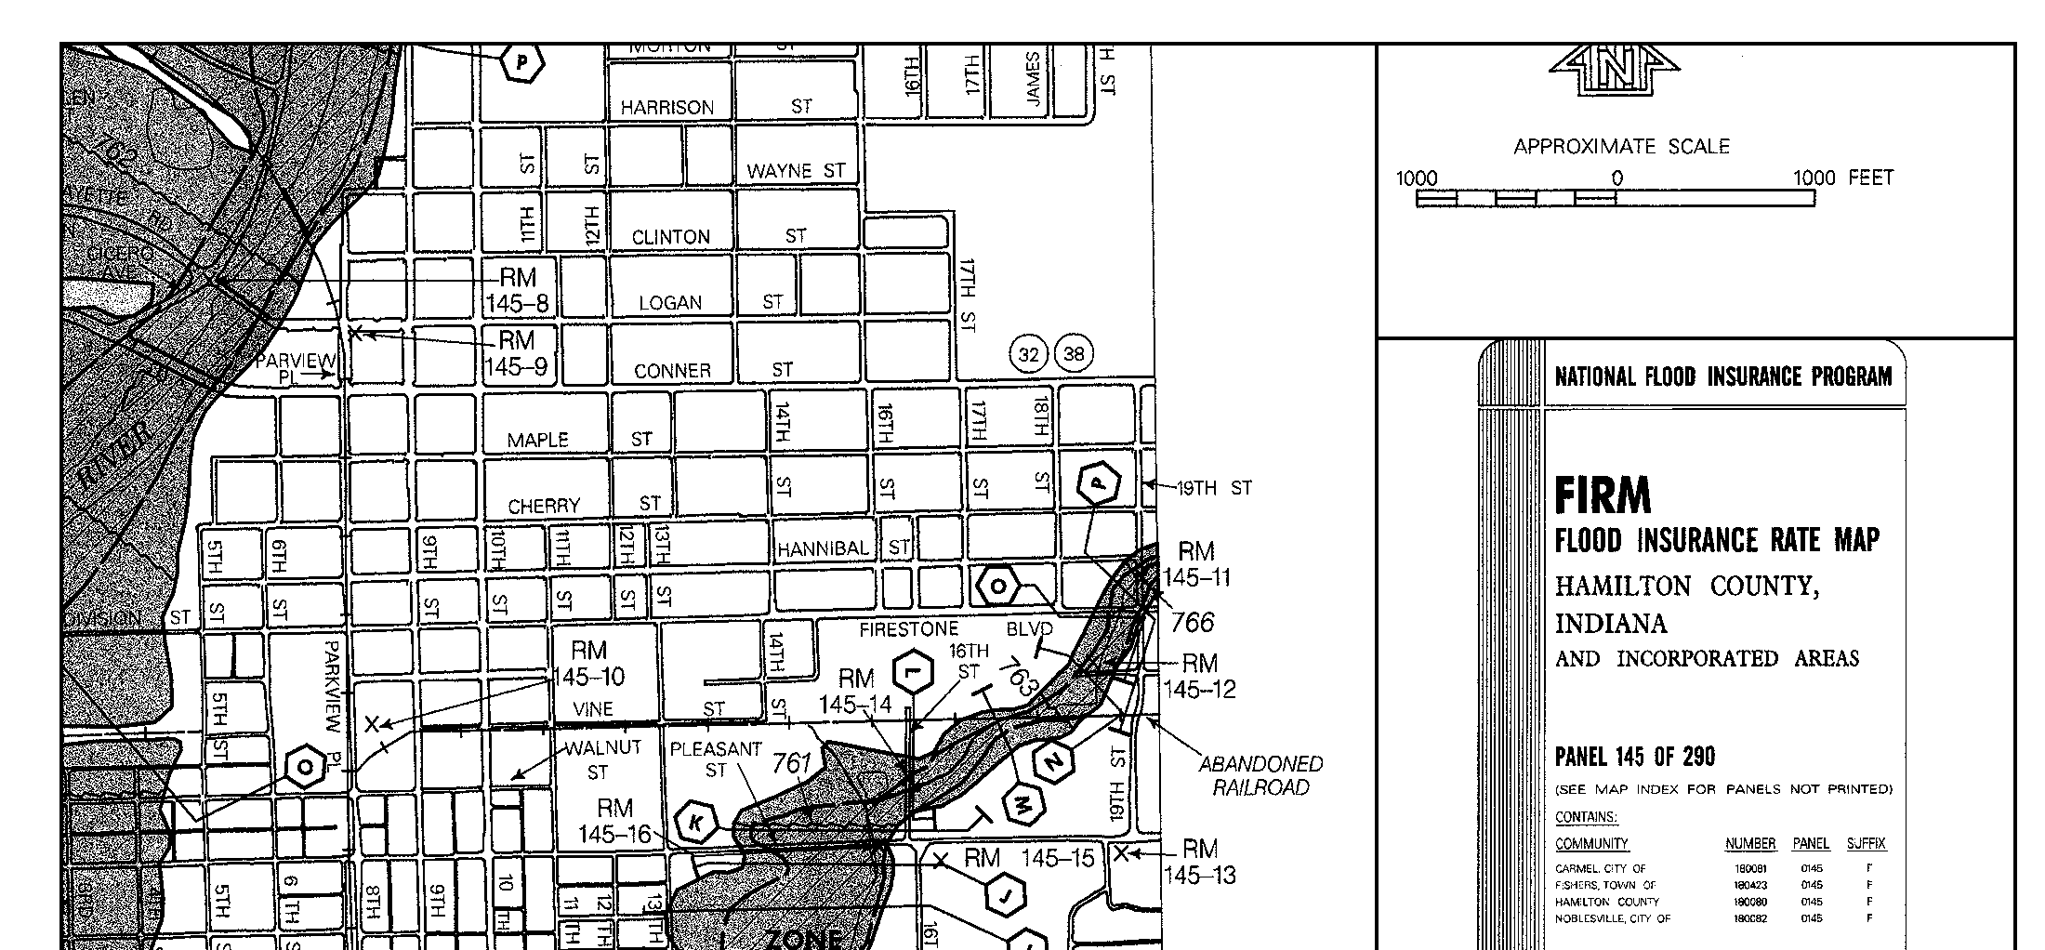
Flood Insurance Rate Map (FIRM)
Base Flood Elevation
Affordable Home Site
FIRM area available on the FEMA online Map Service at http://msc.fema.gov
Notes:
FEMA produces Flood Insurance Rate Maps which locate special flood hazard areas. Special flood hazard areas are predicted to flood during a 100-year storm (i.e., areas that have a 1-percent chance of flooding in any given year). Base flood elevations (BFE) are given on the FIRM for flood-prone areas. A BFE is the predicted elevation of flood water during a flood and is used to design structures in these areas.
The Affordable Home site is not within a special flood hazard area.
Civil Engineering and Architecture
Unit 2- Lesson 2.3 – Residential Design
Project Lead The Way, Inc
Copyright 2010
Residential Foundations

Slide 13
Drainage
Ground should be sloped away from the building
Provide drainage pipe along continuous foundations
Ground floor should be located 6" – 8" above grade
Notes:
Your project design should promote water drainage away from the structure.
Civil Engineering and Architecture
Unit 2- Lesson 2.3 – Residential Design
Project Lead The Way, Inc
Copyright 2010
Residential Foundations

Slide 14
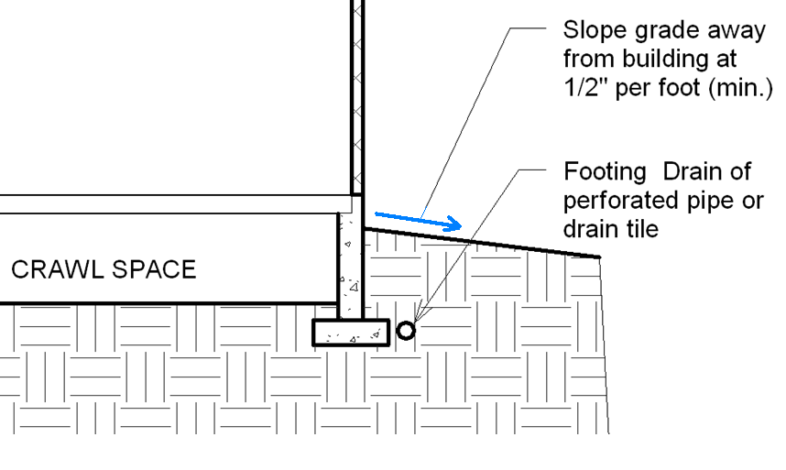
Drainage
8"
Notes:
Civil Engineering and Architecture
Unit 2- Lesson 2.3 – Residential Design
Project Lead The Way, Inc
Copyright 2010
Residential Foundations

Slide 15
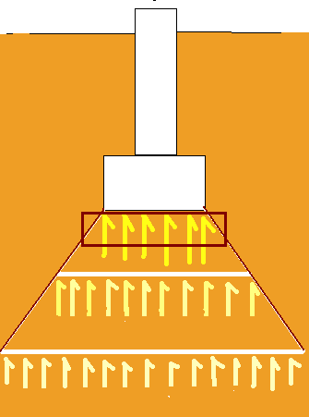
Shallow Foundations
Transfers loads to the soil very near the surface
  Spread footing or strip footing
  Slab-on-grade
Notes:
Most residential foundations are shallow foundations (i.e., the foundations bear on soil very close to the surface).
Civil Engineering and Architecture
Unit 2- Lesson 2.3 – Residential Design
Project Lead The Way, Inc
Copyright 2010
Residential Foundations

Slide 16
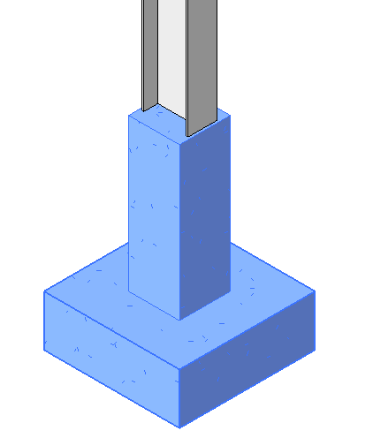
Spread (Column) Footing
COLUMN
LOAD
A footing that spreads the load over a broad area which supports one (or a few) load(s)
USES
Under piers or columns
PIER (Concrete or Masonry)
SPREAD FOOTING (Concrete)
Notes:
Civil Engineering and Architecture
Unit 2- Lesson 2.3 – Residential Design
Project Lead The Way, Inc
Copyright 2010
Residential Foundations

Slide 17
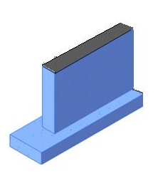
Continuous (Strip) Foundation
A wide strip of reinforced concrete that supports loads from a bearing wall
USES
Under foundation walls
For crawl space/basement
LOAD
FOUNDATION WALL (Concrete or Masonry)
STRIP FOOTING
(Concrete)
Notes:
Civil Engineering and Architecture
Unit 2- Lesson 2.3 – Residential Design
Project Lead The Way, Inc
Copyright 2010
Residential Foundations

Slide 18
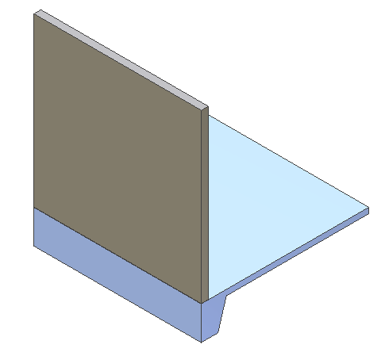
Slab-on-Grade and Thickened Slab
WALL
Slab-on-Grade – Reinforced concrete floor supported by soil
Thickened Slab – A slab on grade with an integral footing created by thickening the slab
USES
Shallow frost depth or when frost protection is used (instead of strip footing)
SLAB-ON-GRADE
THICKENED SLAB
Notes:
Civil Engineering and Architecture
Unit 2- Lesson 2.3 – Residential Design
Project Lead The Way, Inc
Copyright 2010
Residential Foundations

Slide 19
Residential Foundations
Purpose
Considerations
Types of Foundations
  Shallow Foundations
    Spread Footings
    Strip Foundations
    Slab-on-Grade
    Thickened Slabs
Notes:
Civil Engineering and Architecture
Unit 2- Lesson 2.3 – Residential Design
Project Lead The Way, Inc
Copyright 2010
Residential Foundations

